Slide 1
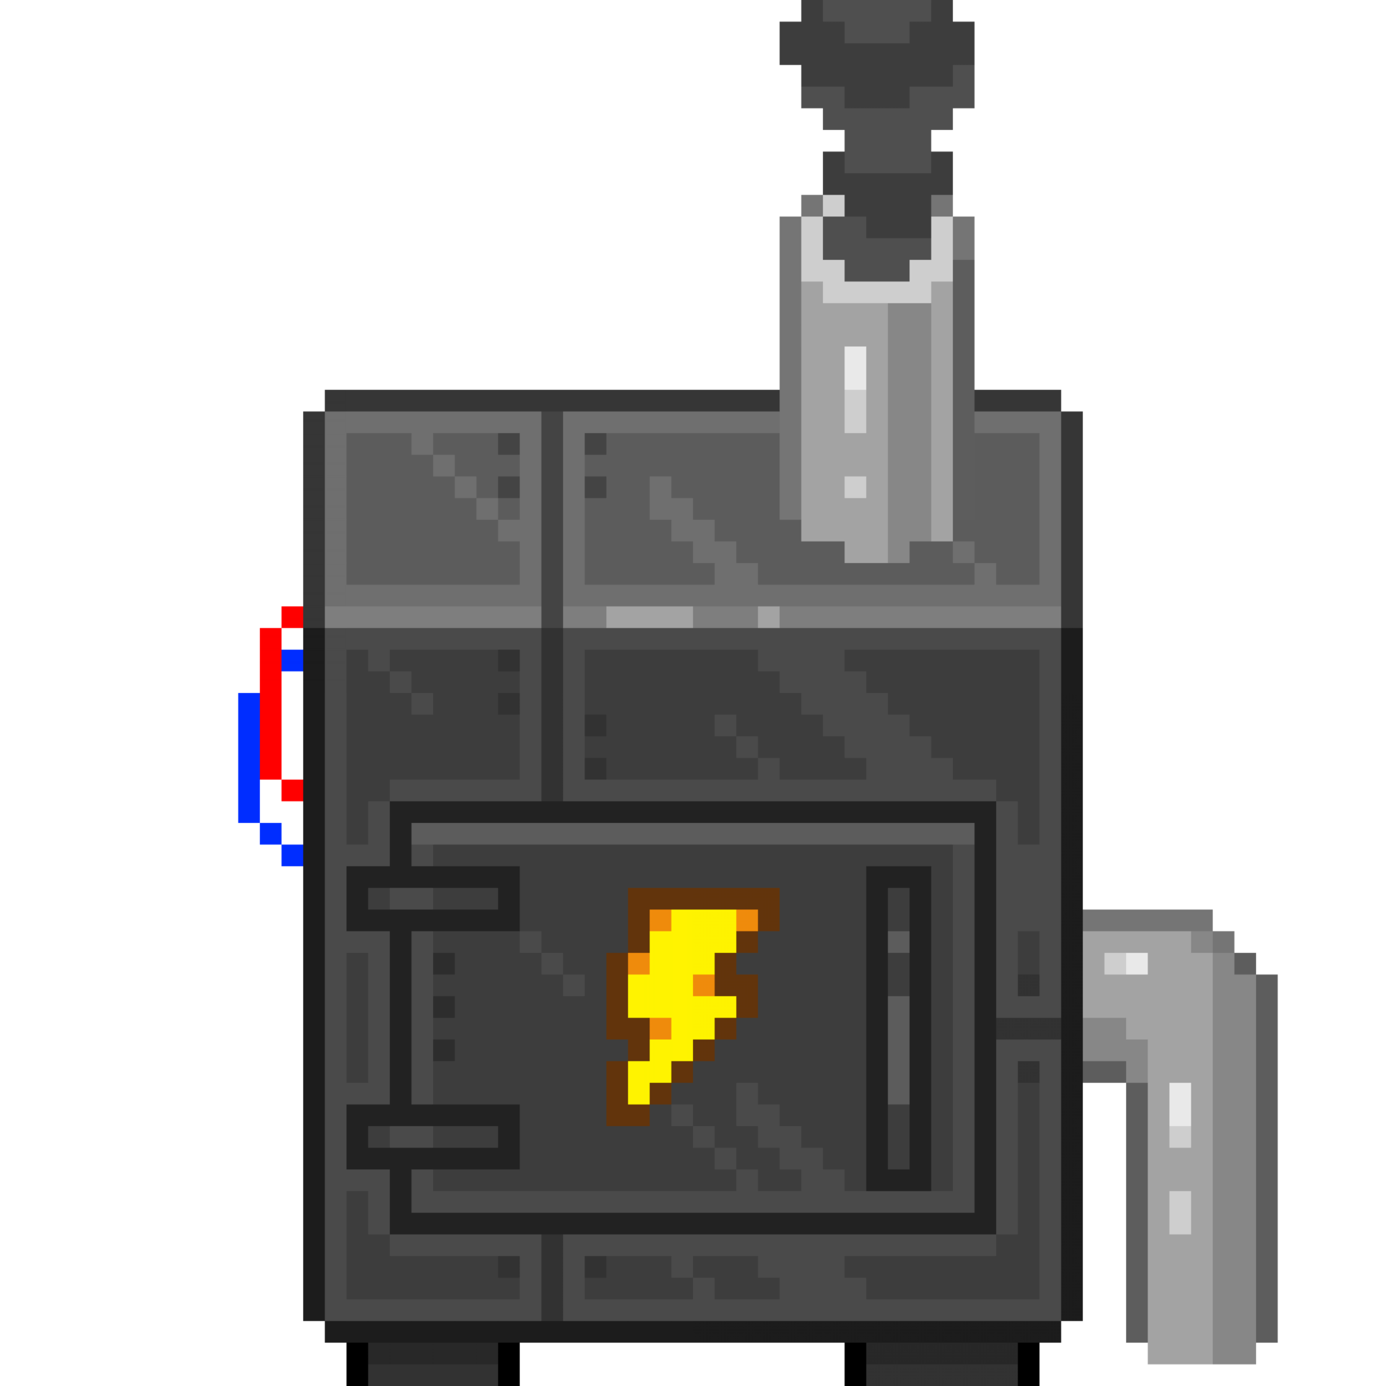
Heathub Electronics and electrical equipment store
Roman Litvinov 6MI8000023

Slide 2
Agenda
Working process | GitHub observe: https://github.com/rlytvynov/HeatHub
About Project | HeatHub is an innovative online shop offering a wide range of heating products, from traditional radiators to cutting-edge smart thermostats and also electro items. Our mission is to provide high-quality products and exceptional customer service. Chat with admin build in.
Used Technologies | Technologies used to implement an application
Diagrams | Use-case, E/R diagrams
Demonstration | Demonstration of how an application works
Future of the project | Upcoming updates

Slide 3
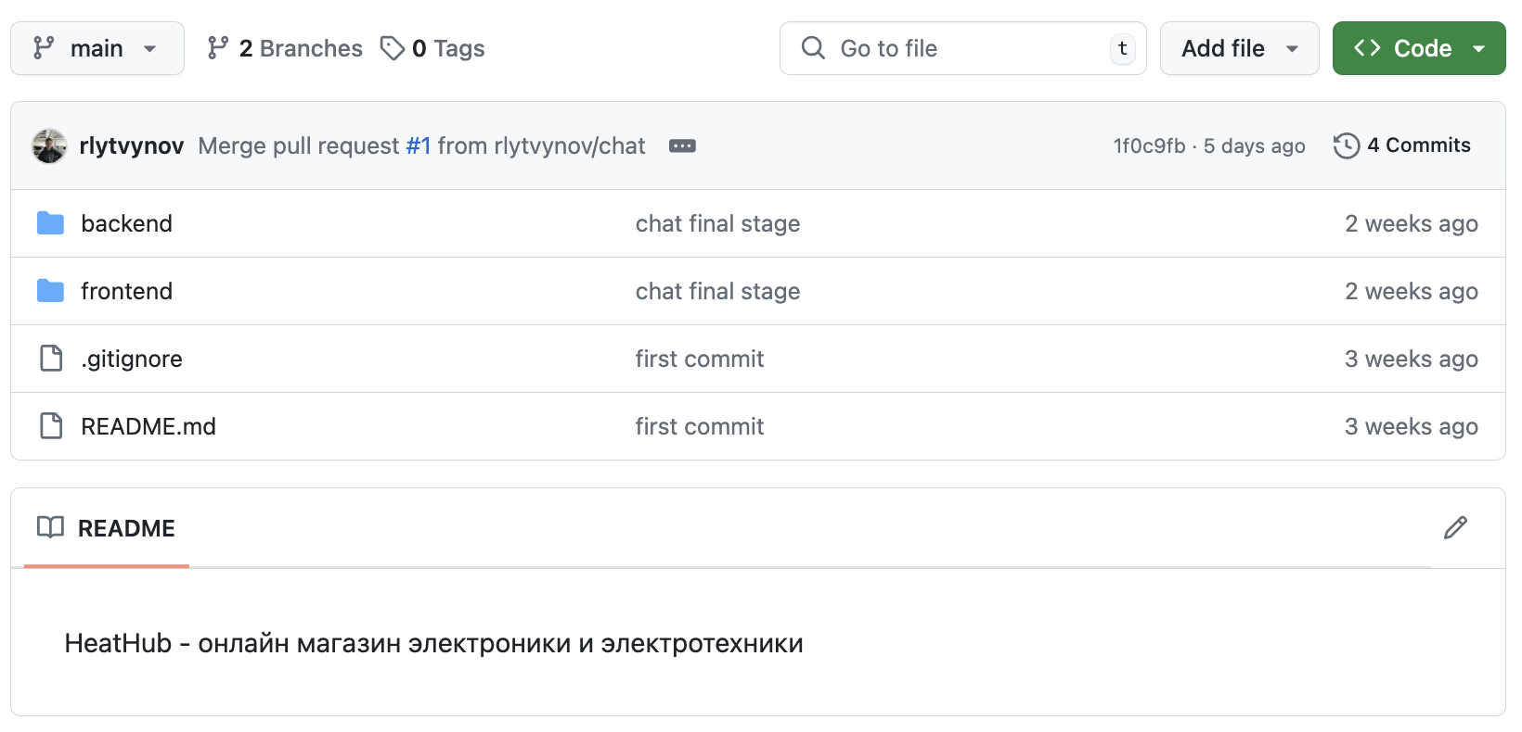
Working Process
main
dev
navigation
auth
chat
items
Notes:
За да организира процеса на работа използвах GitHub. GitHub е решение за управление на git хранилище, където е удобно да имплементира различни етапи на разработка

Slide 4
About Project
01
02
03
04
SPA Application
REST based project
Fast navigation, dynamical data loading
Stateless application
WEB Socket
MongoDB Atlas
Real time events
Cloud-based data storage solution

Slide 5
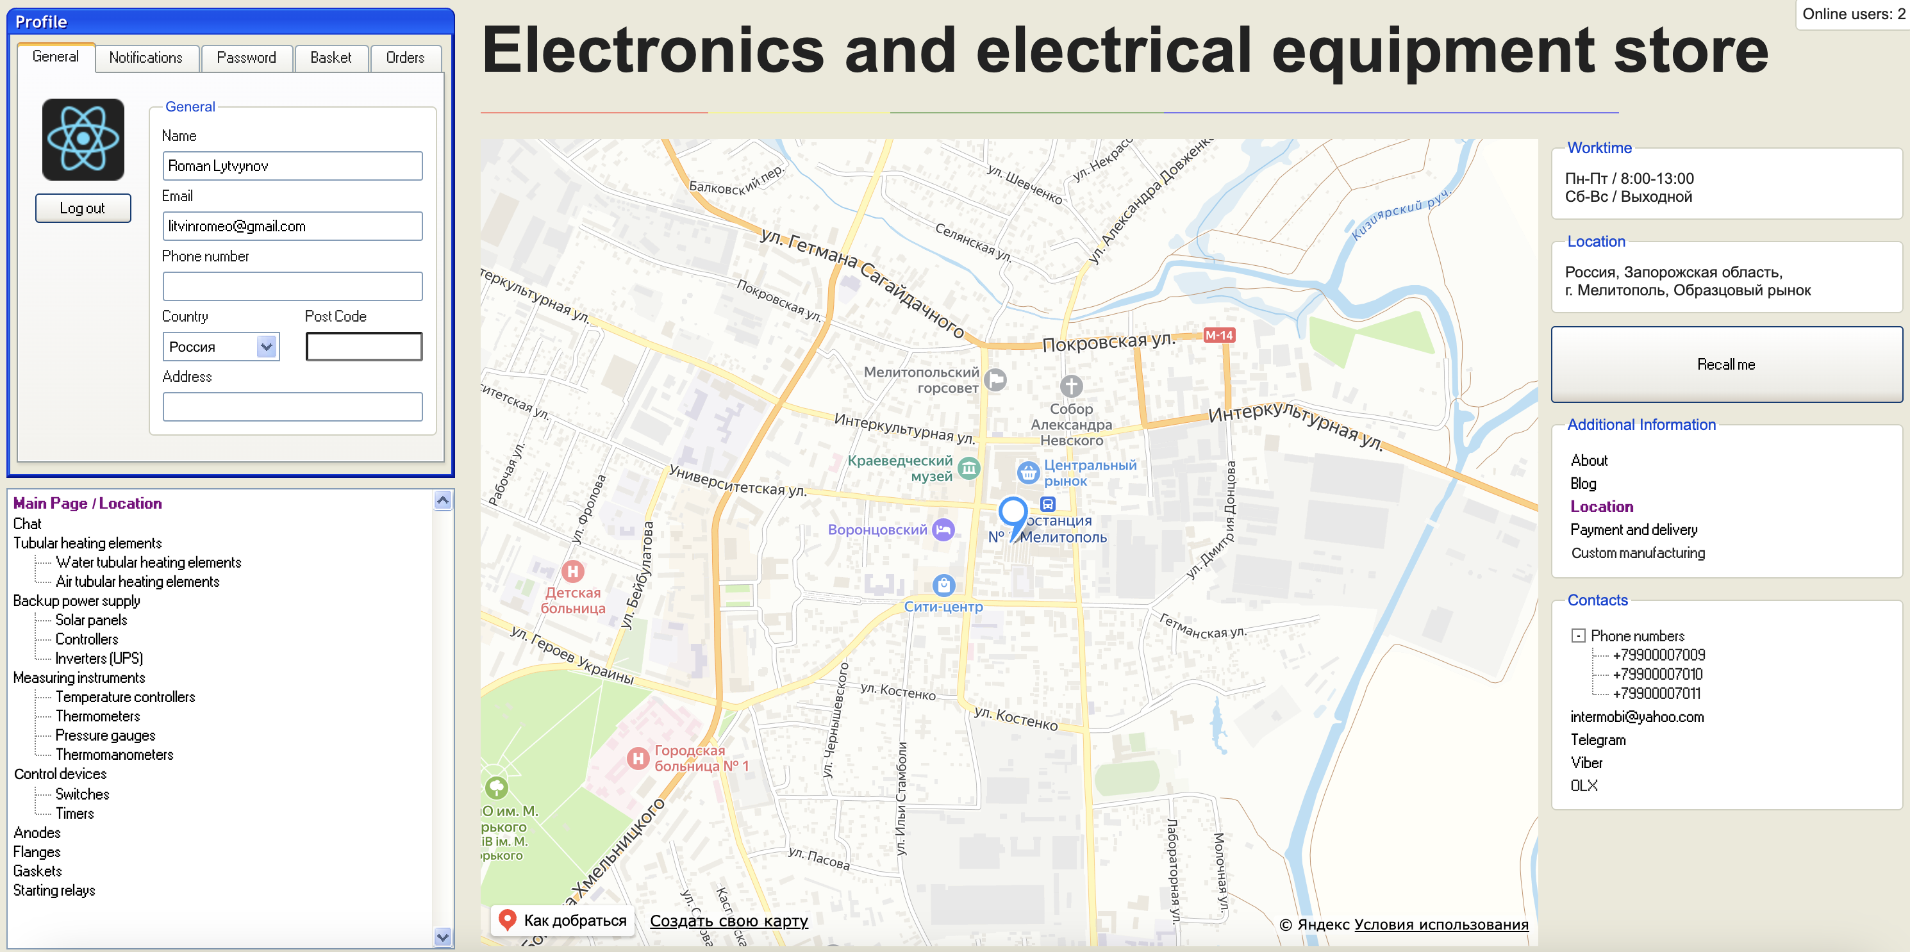
About Project

Slide 6


About Project
HTTP
WS
WS request
GET /api/users
Handshake
{“status”: 200, “users”: []}
Connected
send-message
POST /api/auth/login
new-message
{
“status”: 200,
“user”: {”id”: 21},
“token”: “Bearer ...”
}
Disconnected

Slide 7












Used Technologies

Slide 8
Diagrams

Slide 9
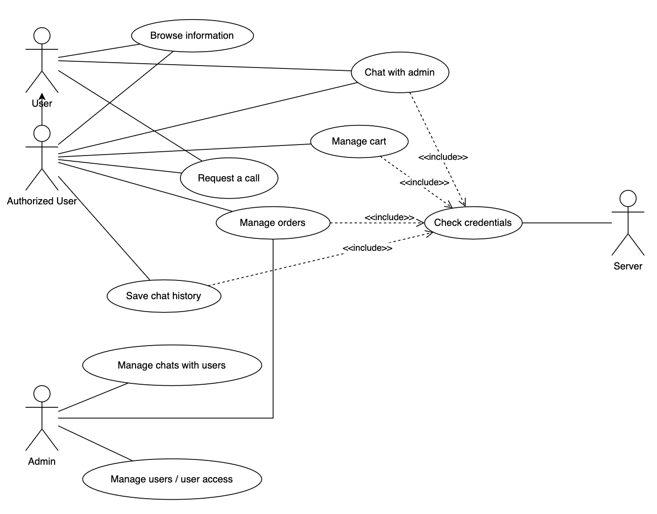
Use-case diagram

Slide 10
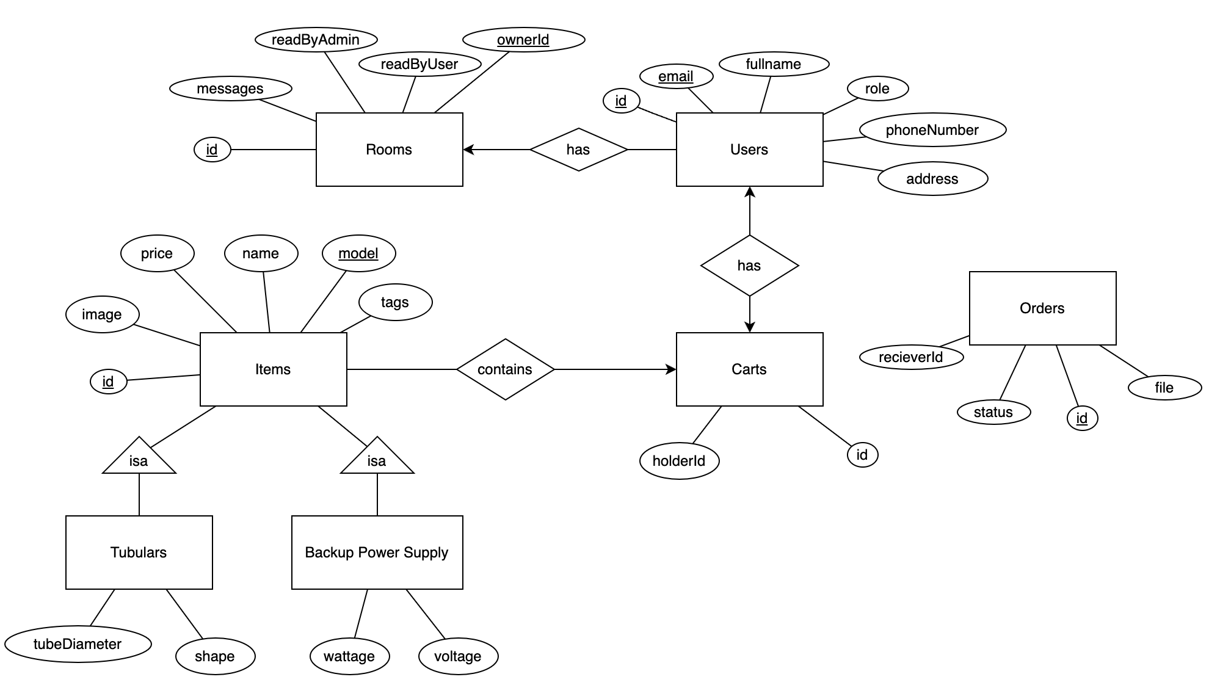
E/R diagram

Slide 11
Demo

Slide 12
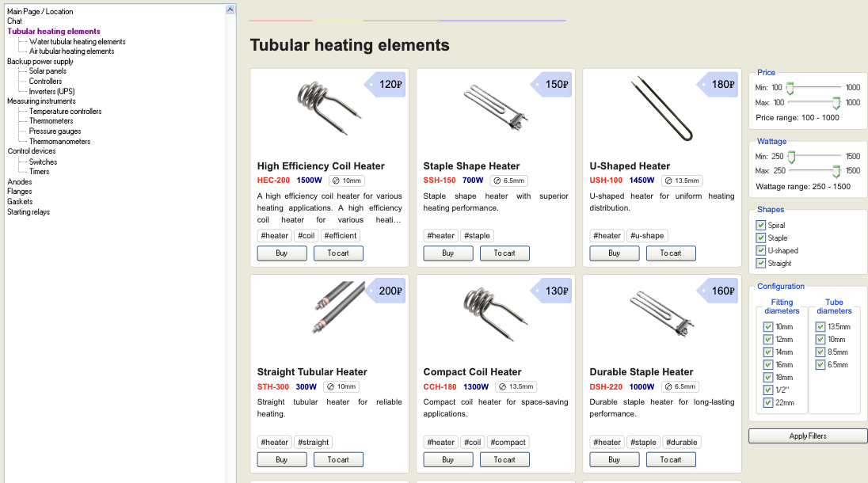
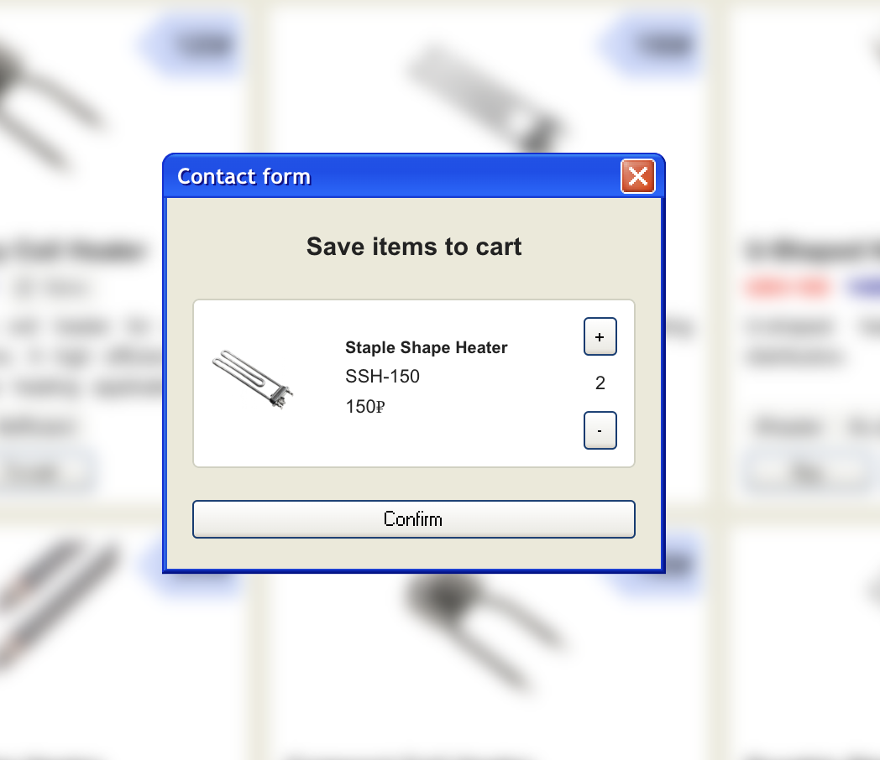
Demonstration
Items common view page

Slide 13
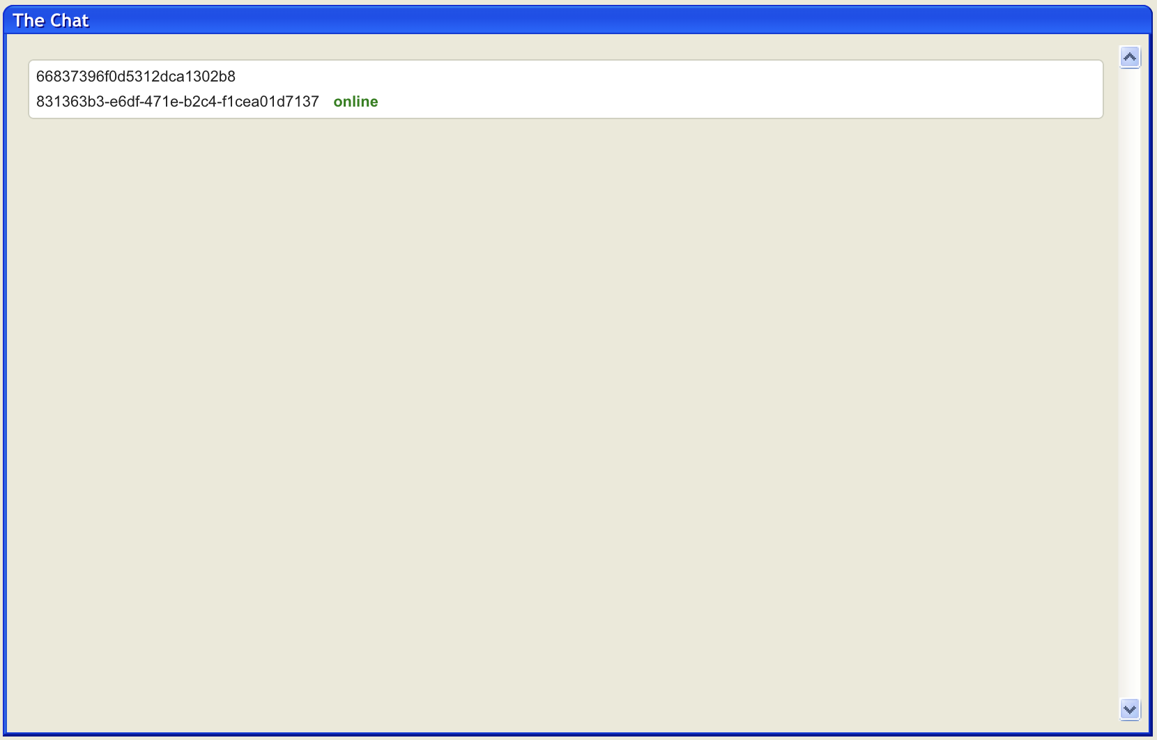
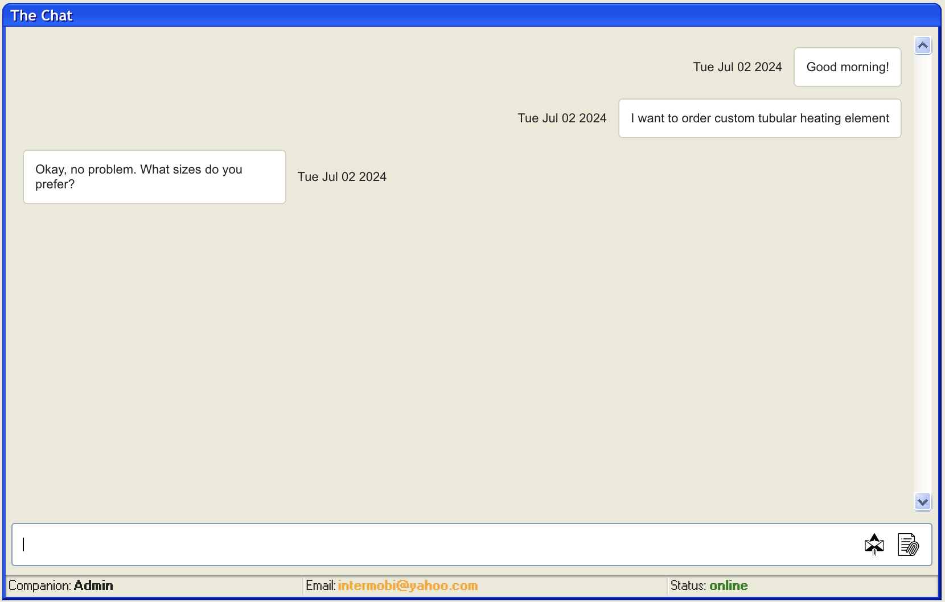
Demonstration
Chat page
User chats (admin view)
Common chat

Slide 14
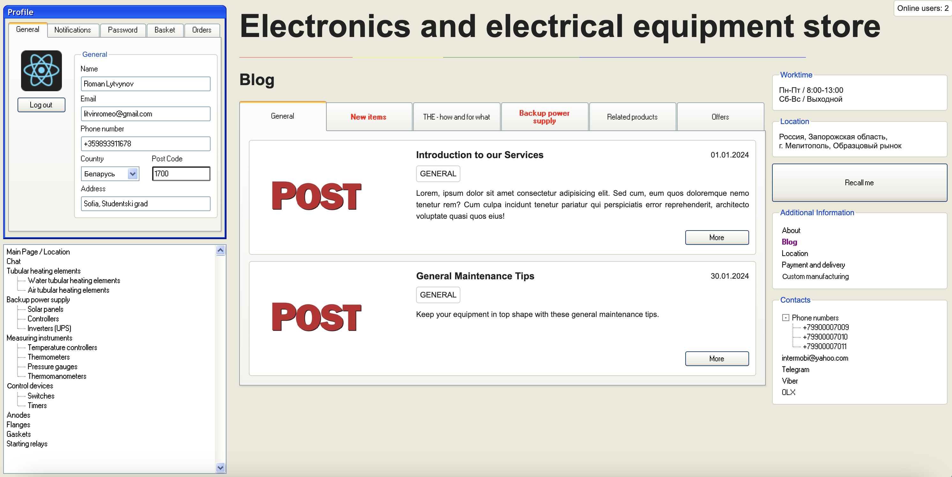
Demonstration
Blog page

Slide 15
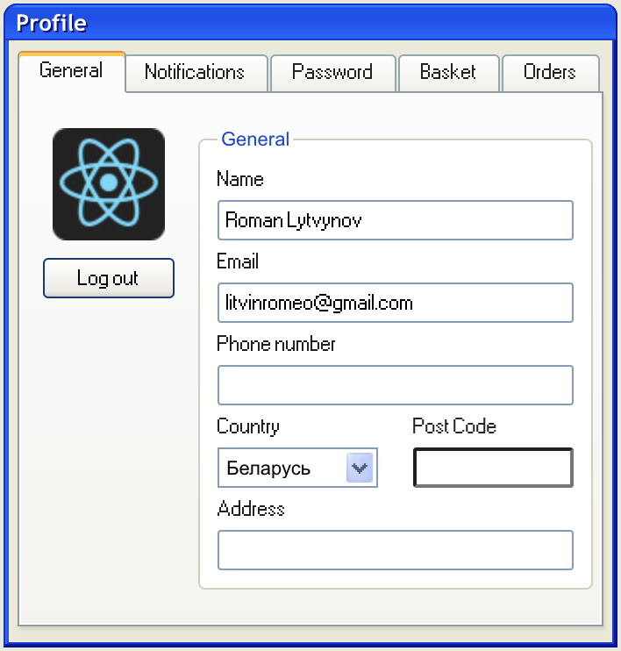
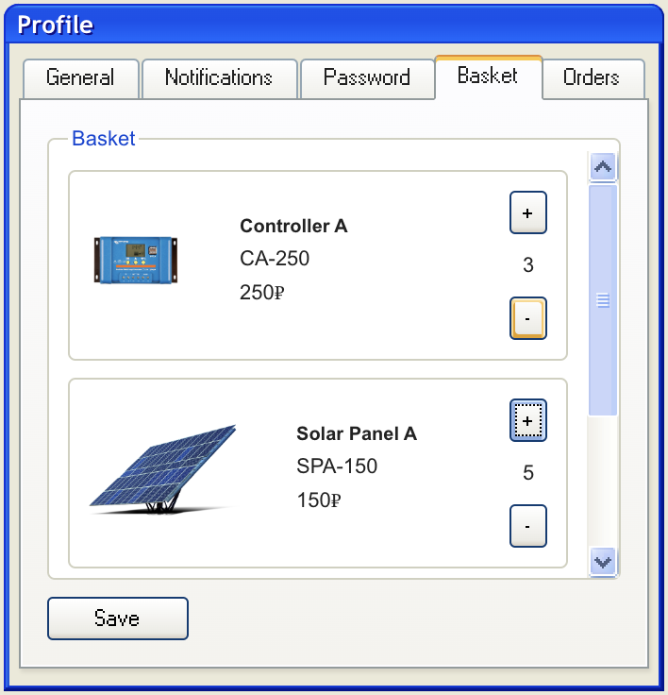
Demonstration
Profile component

Slide 16
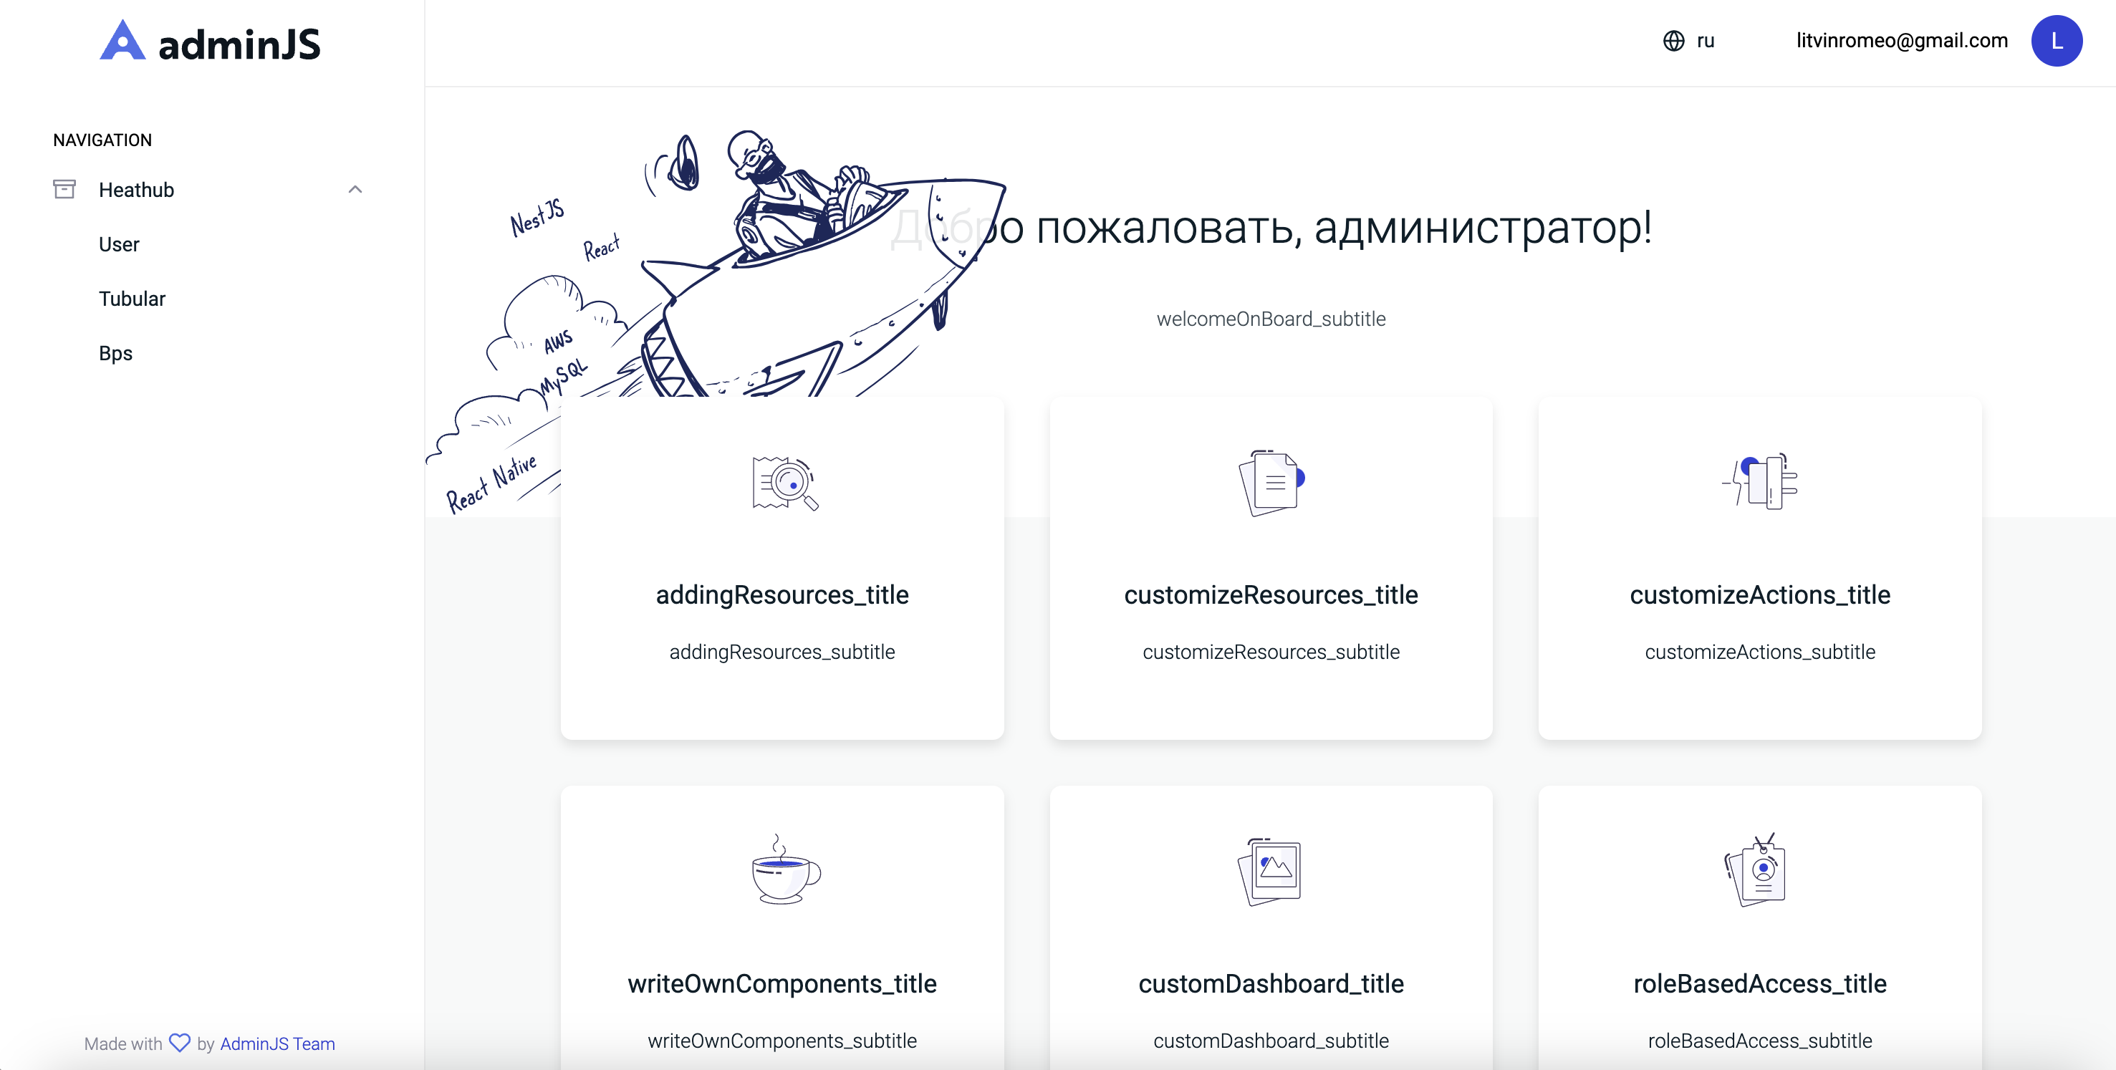
Demonstration
Admin panel

Slide 17
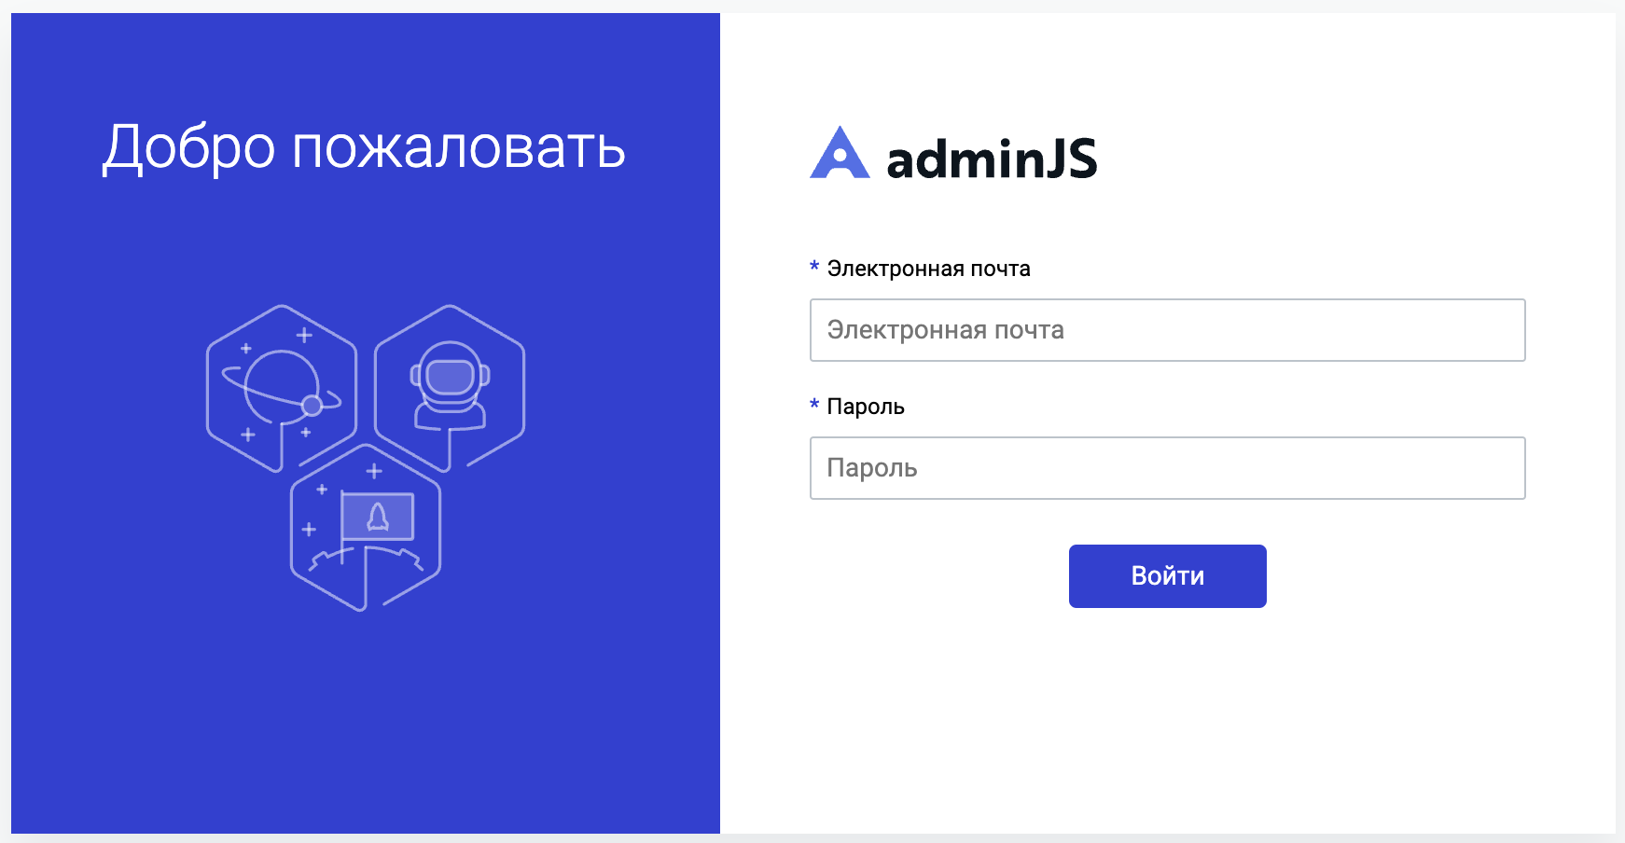
Demonstration
Admin panel

Slide 18
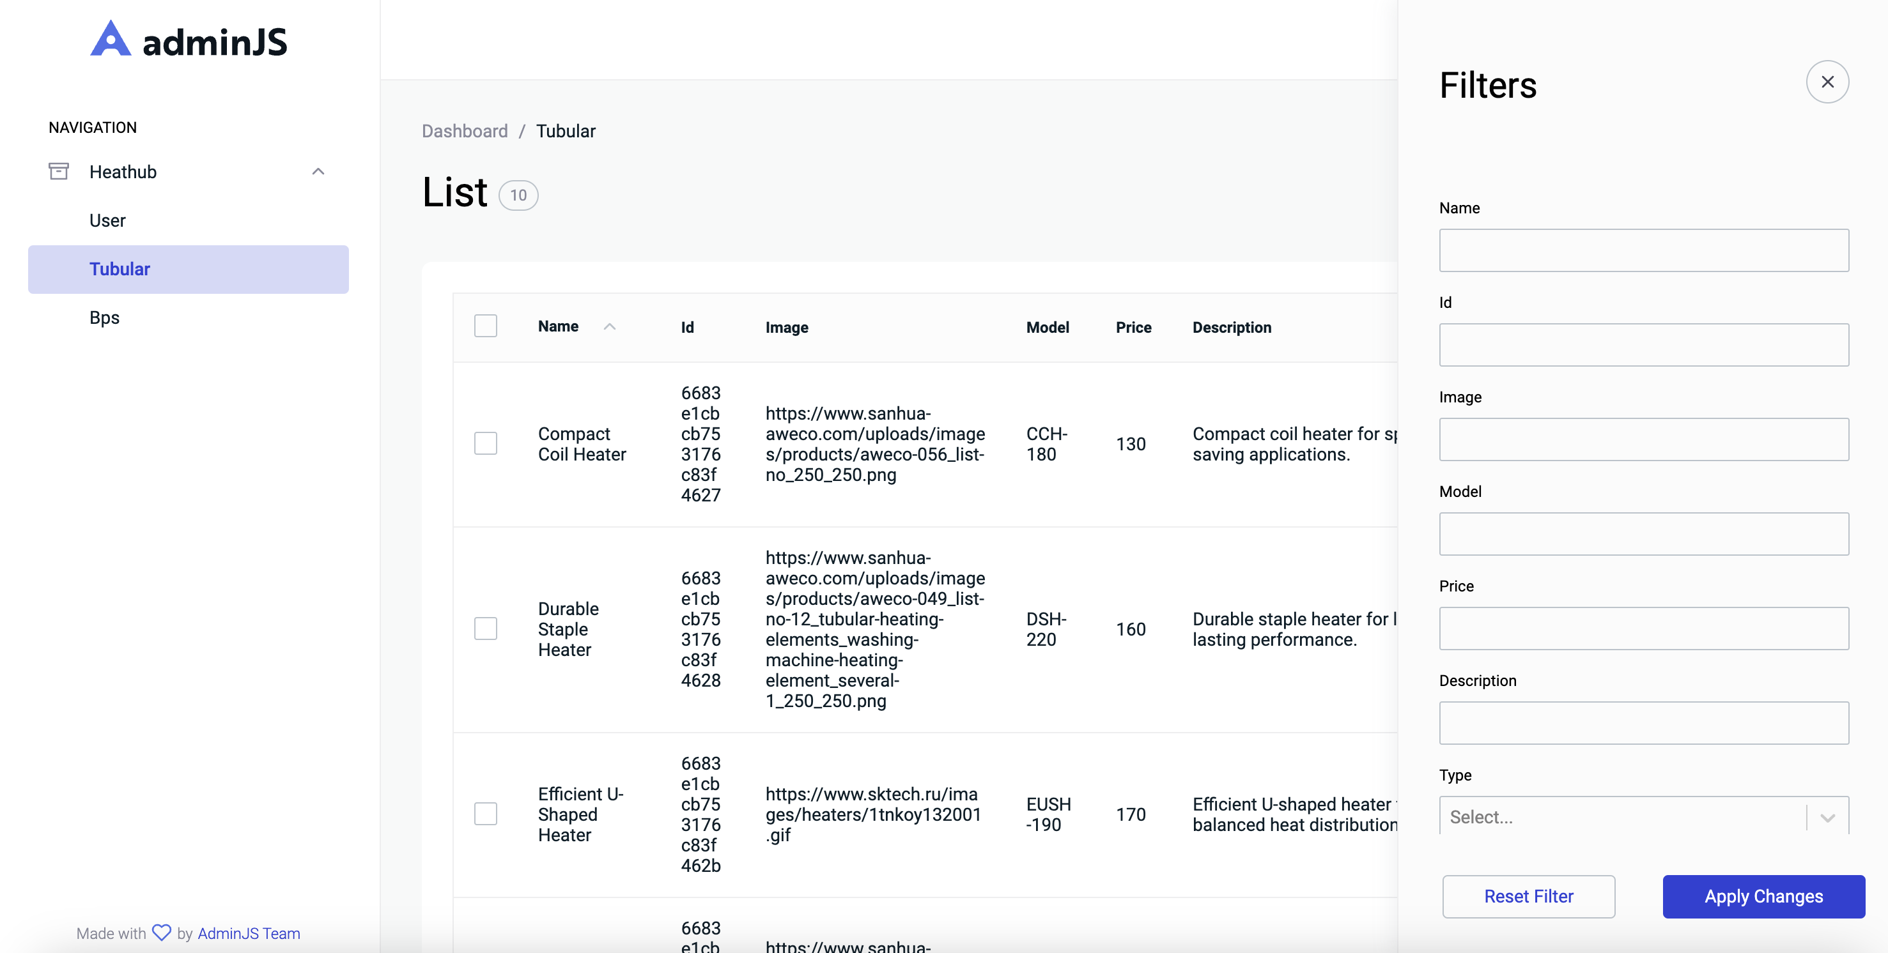
Demonstration
Admin panel

Slide 19
Demonstration
Admin panel

Slide 20
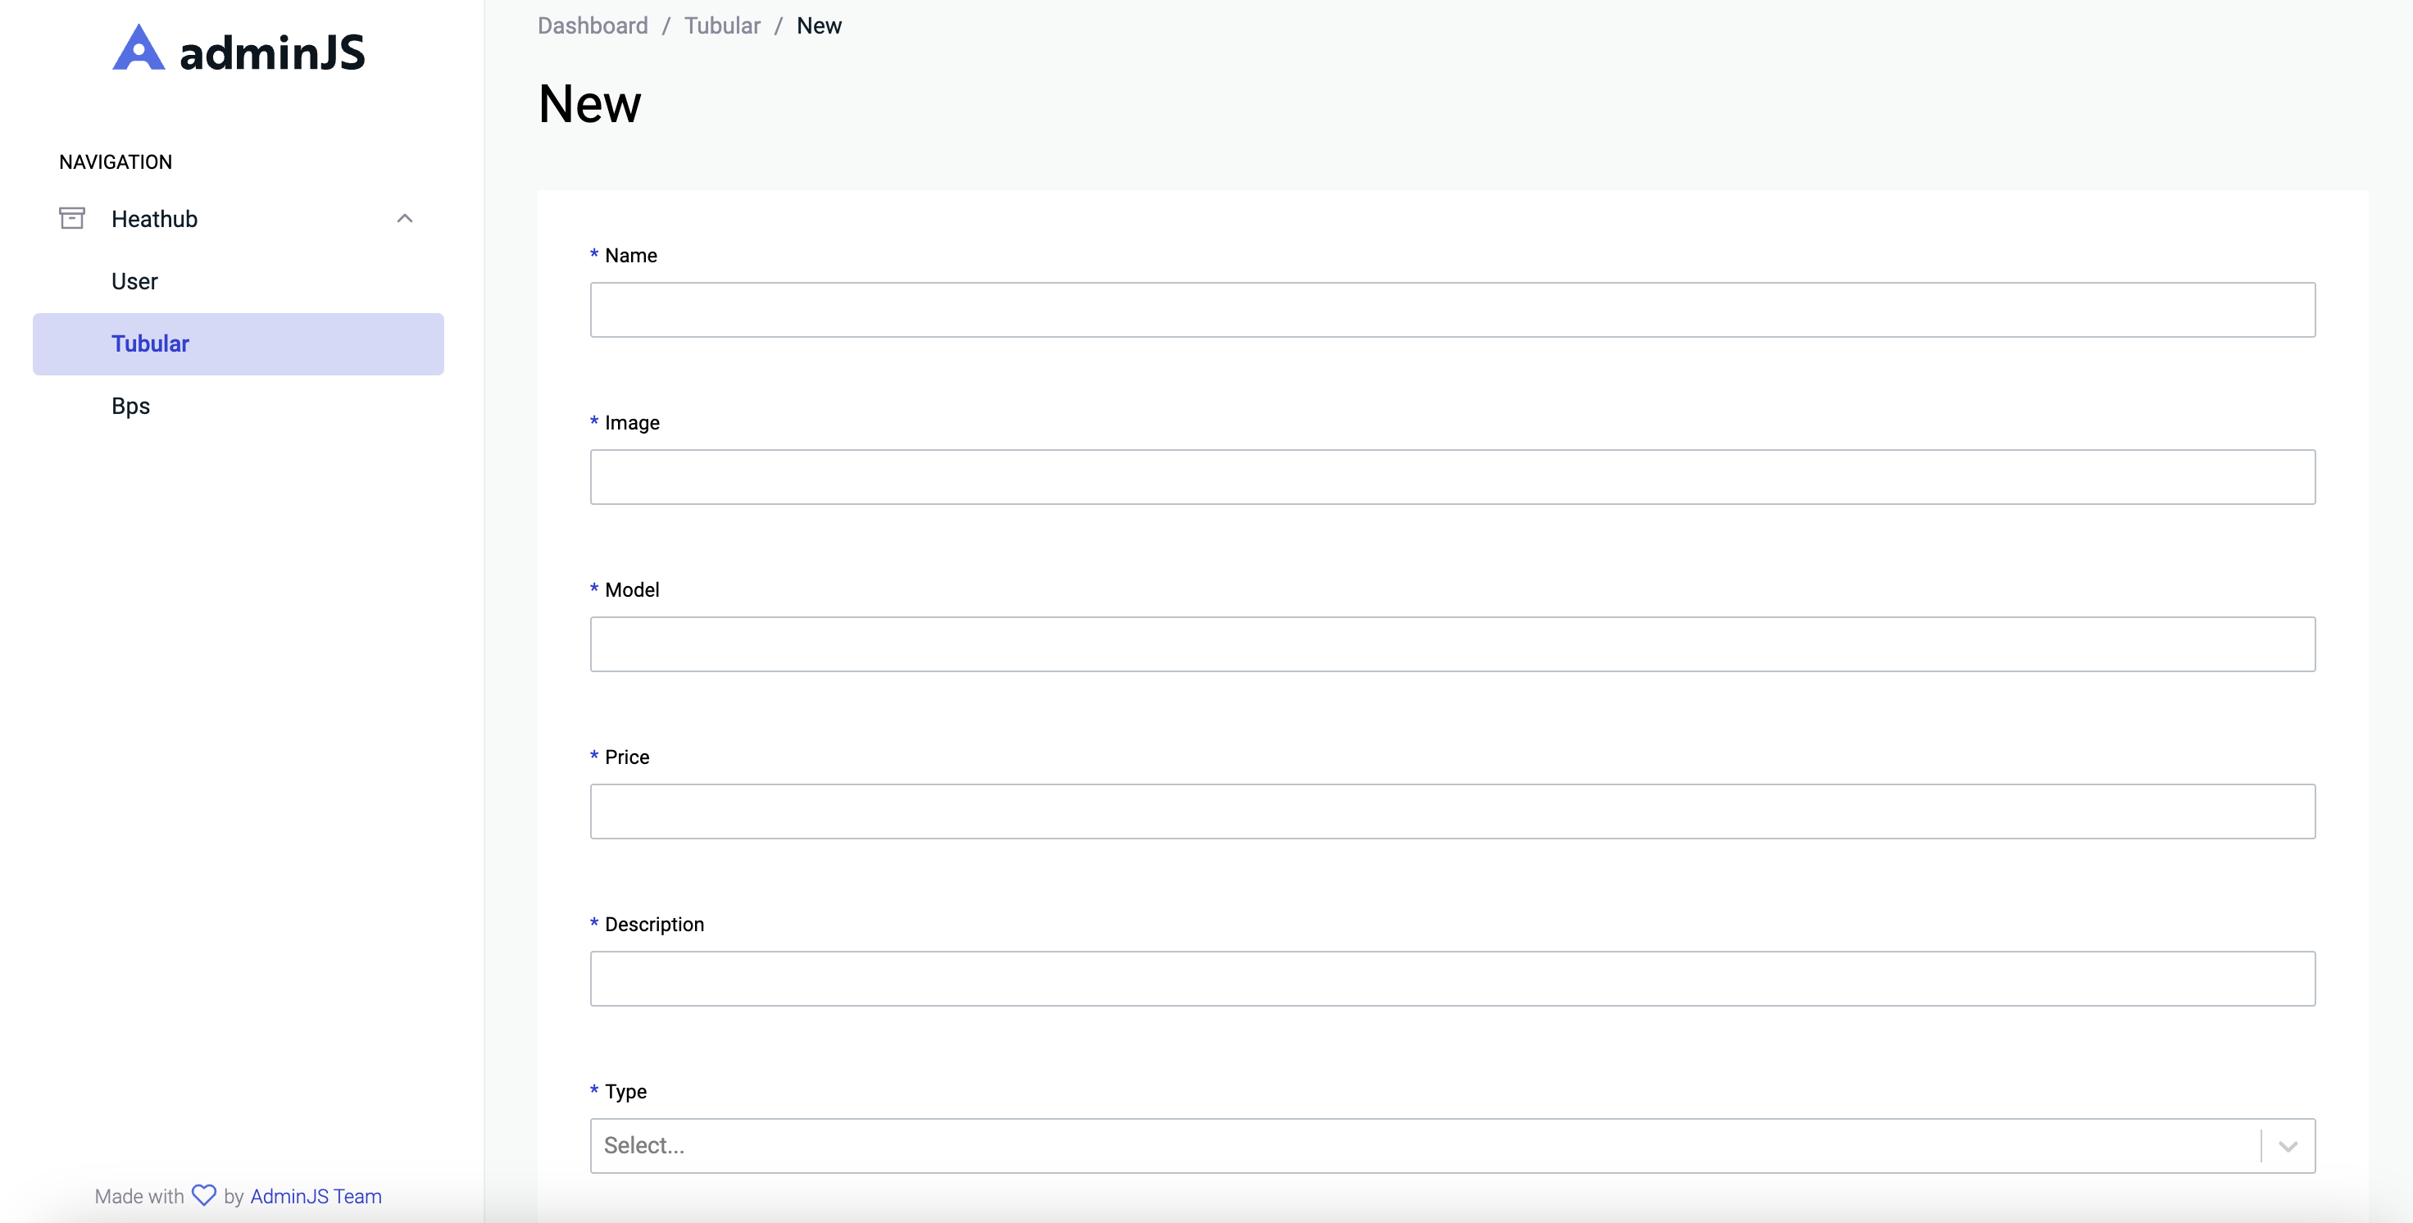
Demonstration
Admin panel

Slide 21
Future?
01 | Payment | Using payment Api
02 | More items | Not all items added to the shop yet
03 | More security | Create 2-token mechanism for more secure data transfer

Slide 22
Thanks!
Do you have any questions?

